Slide 1
For Live Session Assignment Unit 3
Assumption of the T Test

Slide 2
Examples of A Complete Analysis
Statement of the Problem
Address the Assumptions
Perform the Appropriate Test (5 Steps)
Step 6: Provide a conclusion that a non statistician can understand. Include a p-value and confidence interval
Scope of Inference

Slide 3

Example: Beach Comber
The following are ages of 7 randomly chosen patrons seen leaving the Beach Comber in South Mission Beach at 7pm! We assume that the data come from a normal distribution and would like to test the claim that the mean age of the distribution of Comber patrons is different than 21.
25, 19, 37, 29, 40, 28, 31

Slide 4
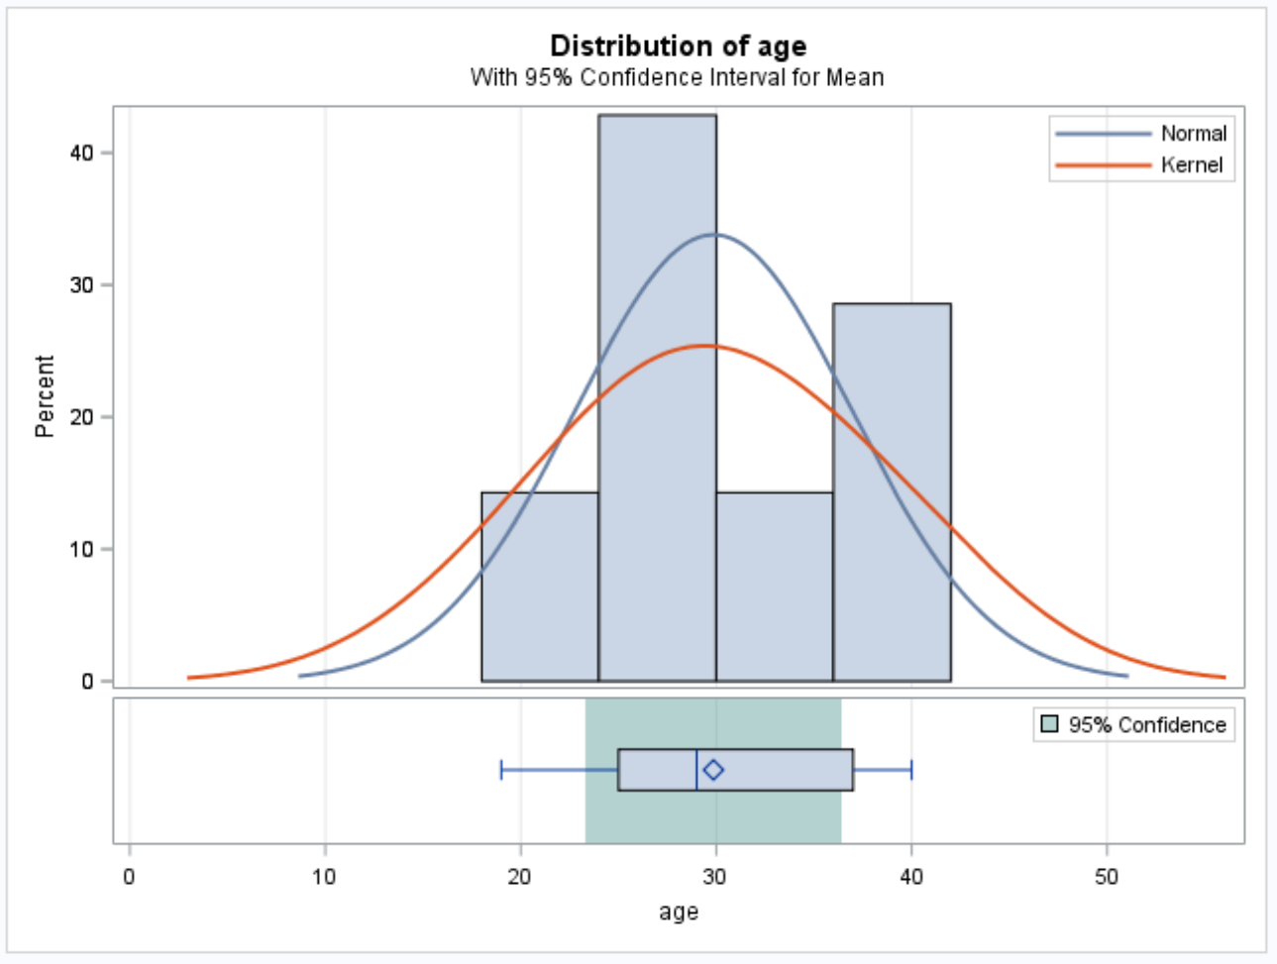
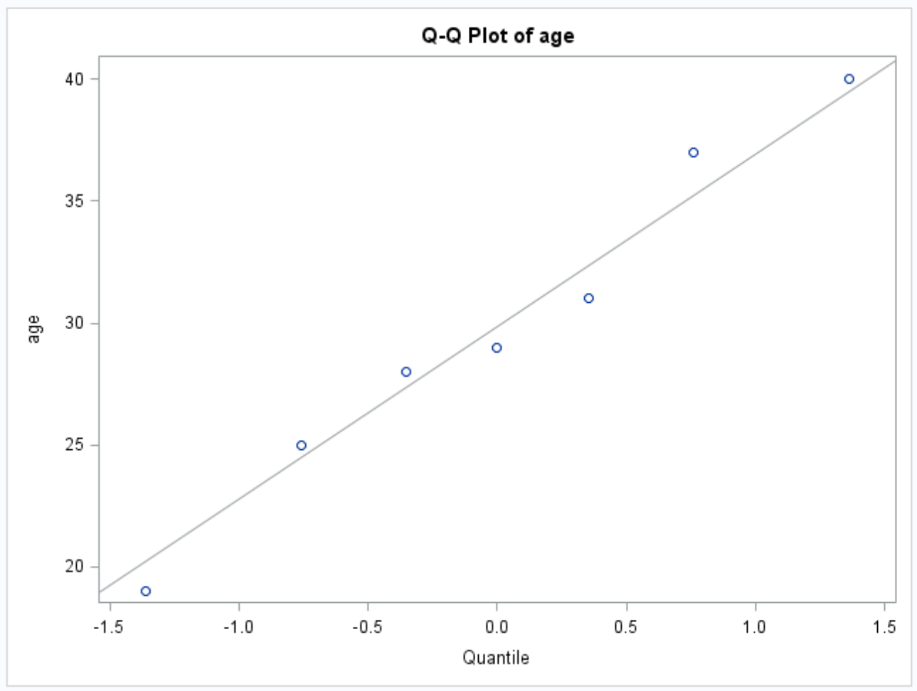
Example: Beach Comber - Continued
Z Value
PROBLEM STATEMENT:
Test the claim that the mean age of Beach Comber patrons at 7pm is different from 21.
ASSUMPTIONS:
Normal Population Distribution: Judging from the histogram and q-q plots, there is little to no evidence that the population distribution of patron ages at the Comber at 7pm is not normal. We will assume that this distribution is normal and proceed.
Independence: These subjects were randomly selected from the population; thus, we will assume that the observations are independent.

Slide 5
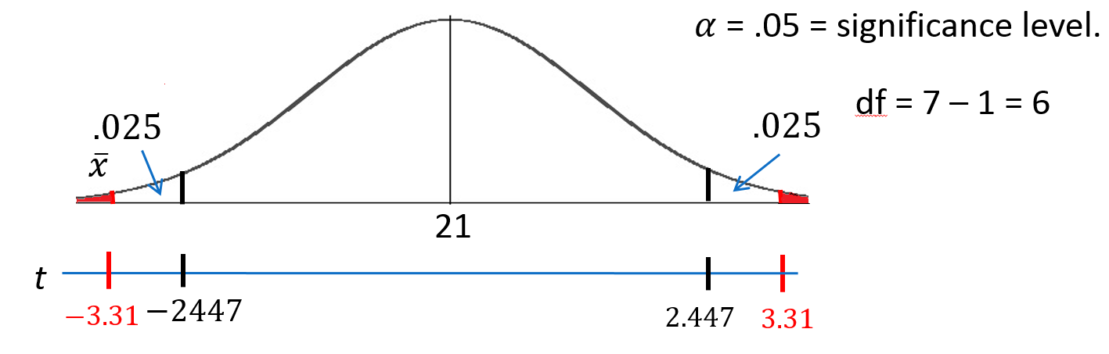
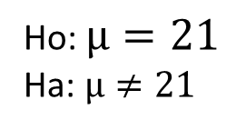



Revised Write Up Beach Comber
We would like to test the claim that the population mean is different from $21.$ To do this, we take a sample of size n = 7 and find that $\overline{x}$ = 29.86 years and s = 7.09 years.
Ho: $µ=21$
Ha: $µ≠21$
Step 1: Identify the null (Ho) and alternative (Ha) hypothesis.
Step 2: Draw and Shade and Find the Critical Value.
proc ttest data = comber h0=21 alpha=0.05; var age; run;
$$t=\frac{\overline{x}−μ}{\frac{s}{\sqrt{n}}}$$
$$=\frac{29.86−21}{\frac{7.09}{\sqrt{7}}}$$
$$=3.31$$
Step 3: Find the test statistic. (The t value for the data.)
Step 4: Find the p-value: P-value = .0162 < .05
Step 5: REJECT Ho
Step 6: There is sufficient evidence to conclude that the true mean age of patrons at the Comber at 7pm is different from 21 (p-value =.0162 from a t-test). A 95% confidence interval for the mean age is (23.3, 36.4) years. Scope: Since this was a random sample, we can generalize these findings to the entire population of Comber patrons at 7pm. Note that we have evidence to support the claim that the mean age is greater than 21 as well.

Slide 6
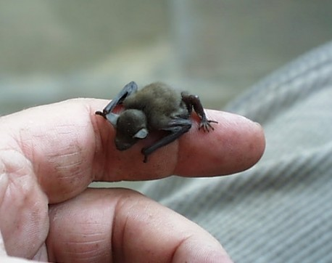
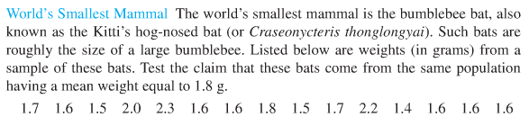
Example: Bats

Slide 7
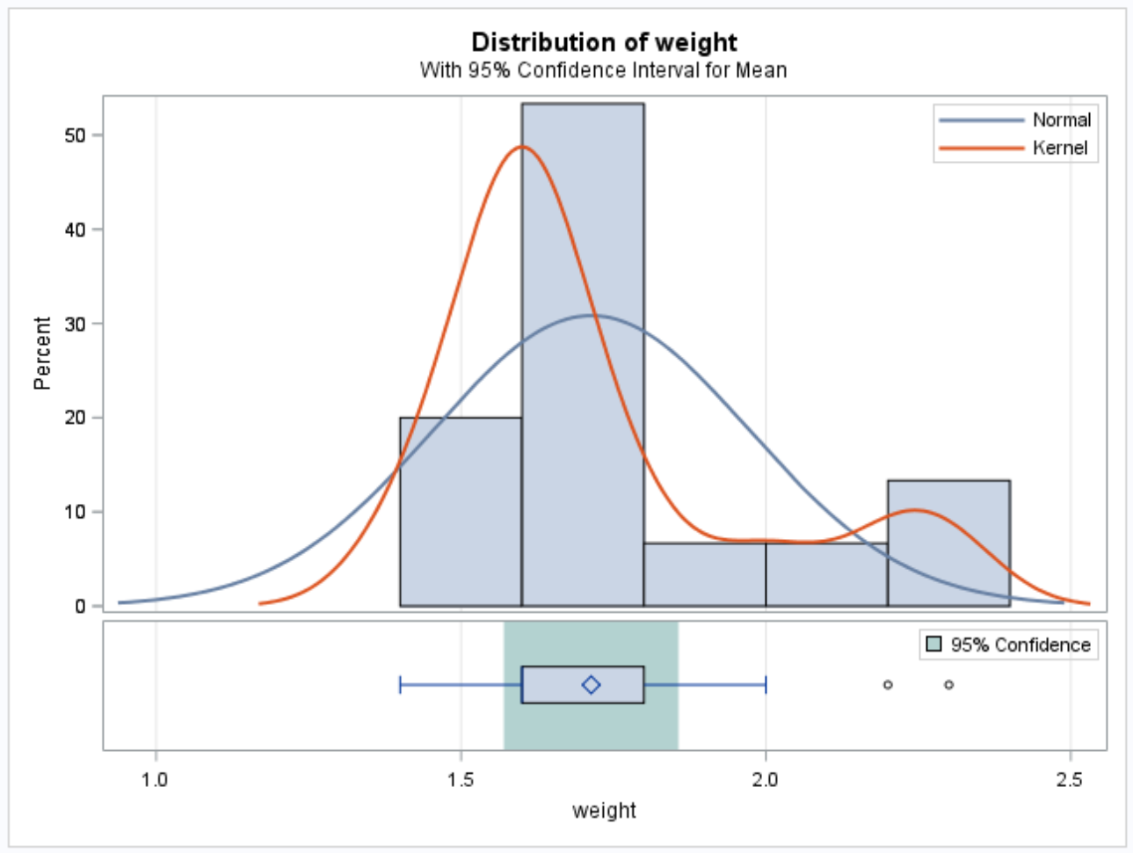
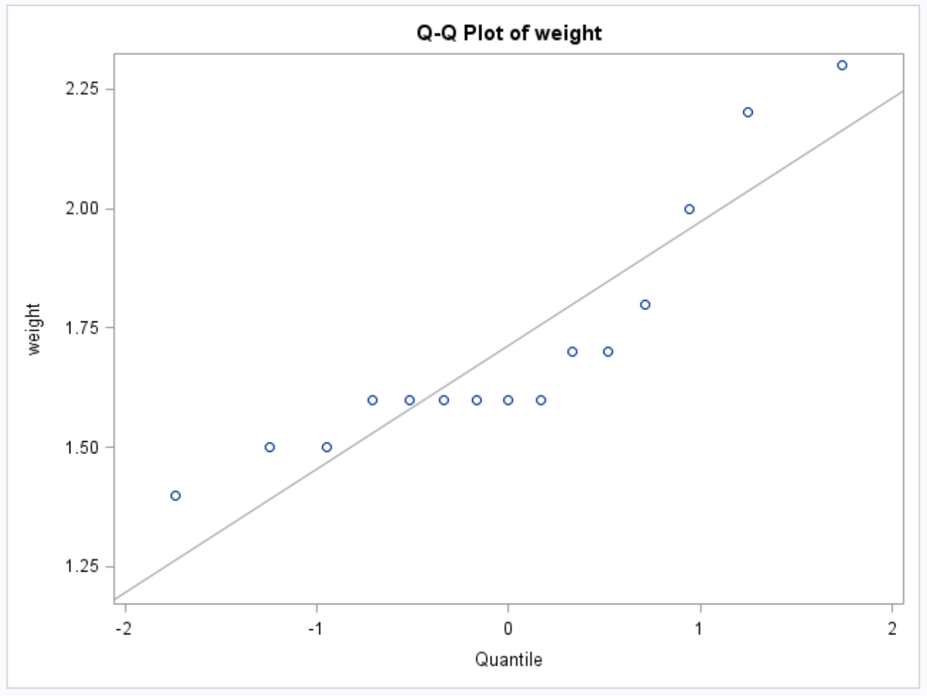
Example: Bats - Continued
PROBLEM STATEMENT:
Test the claim that the mean weight of the bumble bee bat is different from 1.8 g.
ASSUMPTIONS:
Normal Population Distribution: Judging from the histogram and q-q plots, there is some visual evidence of a departure from normality. With a sample size of 15 and no extreme outliers, we will assume the distribution of sample means is well approximated by a normal distribution via the CLT and proceed with caution. Independence: Not much is known about the sampling scheme used to obtain this sample. We will assume the observations are independent.

Slide 8
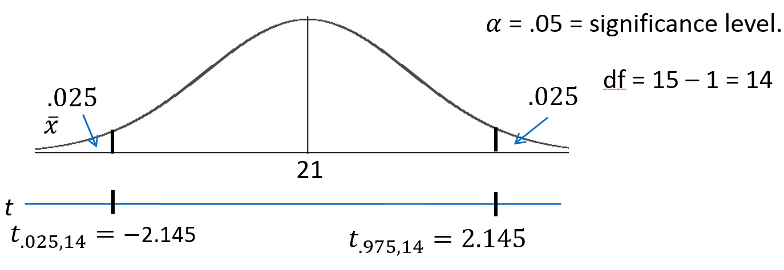
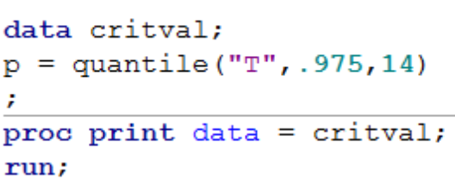
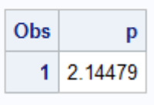
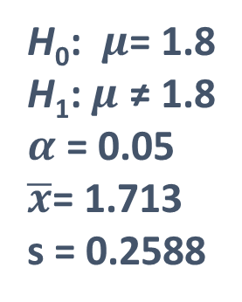

Example Bats
Statistical Test
And Conclusion
proc ttest data = batWeight h0=1.8 alpha=0.05; var weight; run;
H₀: $μ$= 1.8
H₁: $μ$ ≠ 1.8
$α$ = 0.05
$\overline{x}$= 1.713
s = 0.2588
Critical Values
t = ± 2.145
t = $\frac{1.713−1.80}{\frac{0.2588}{\sqrt{15}}}=\text{1.297}$
P-value: Pr(t>1.297)=.0 2155 > .05
Fail to Reject H₀
On the basis of this test, there is not enough evidence to reject the claim that the mean weight of bumblebee bats is equal to 1.8 g (p-value = .2155 from a t-test). A 95% confidence interval is (1.57, 1.8566) grams. The problem was ambiguous on the randomness of the sample; thus, we will assume that it was not a random sample, which makes inference to all bats strictly speculative.

Slide 9
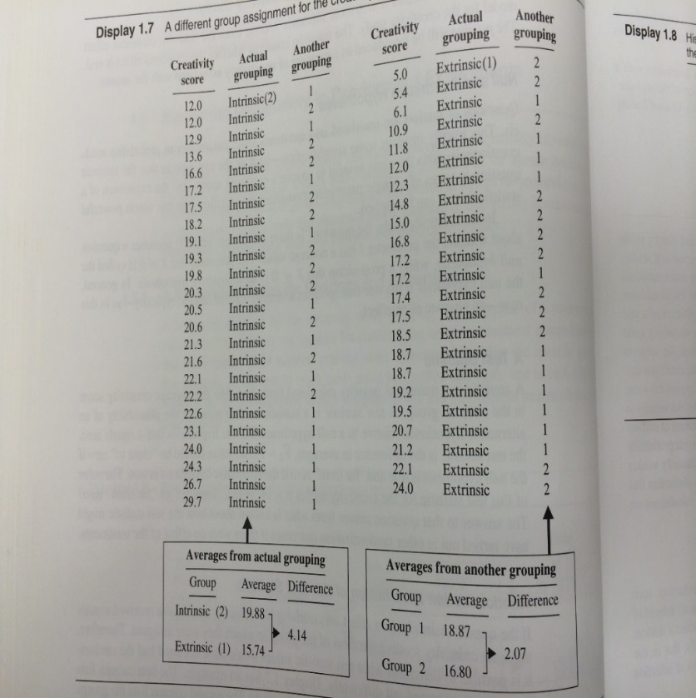
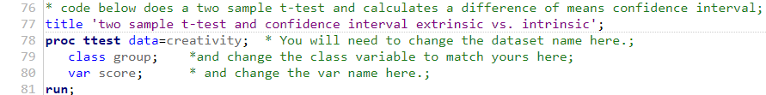
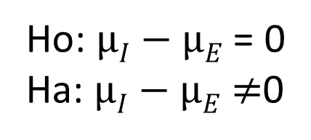
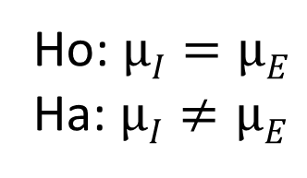
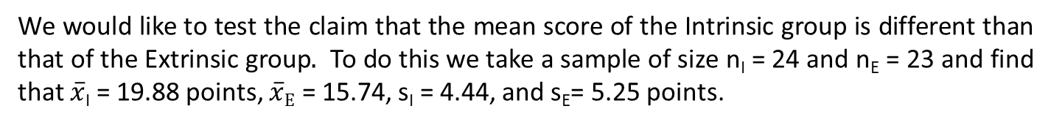
EXAMPLE: CREATIVITY STUDY
We would like to test the claim that the mean score of the Intrinsic group is different than that of the Extrinsic group$.$ To do this we take a sample of size n_{I} = 24 and n_{E} = 23 and find that $\overline{x}$_{I} = 19.88 points, $\overline{x}E$ = 15.74, s_{I} = 4.44, and s_{E}= 5.25 points.
Step 1: Identify the null (Ho) and alternative (Ha) hypothesis.
Ho: $µI=µE$
Ha: $µI≠µE$
Which is equivalent to:
Ho: $µI−µE$ = 0
Ha: $µI−µE$ $≠$0

Slide 10
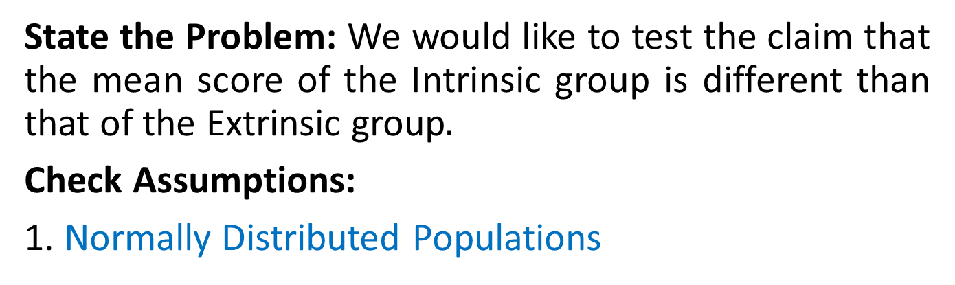
Example: Creativity Data Check Normality Assumption
State the Problem: We would like to test the claim that the mean score of the Intrinsic group is different than that of the Extrinsic group$.$
Check Assumptions:
1. Normally Distributed Populations

Slide 11
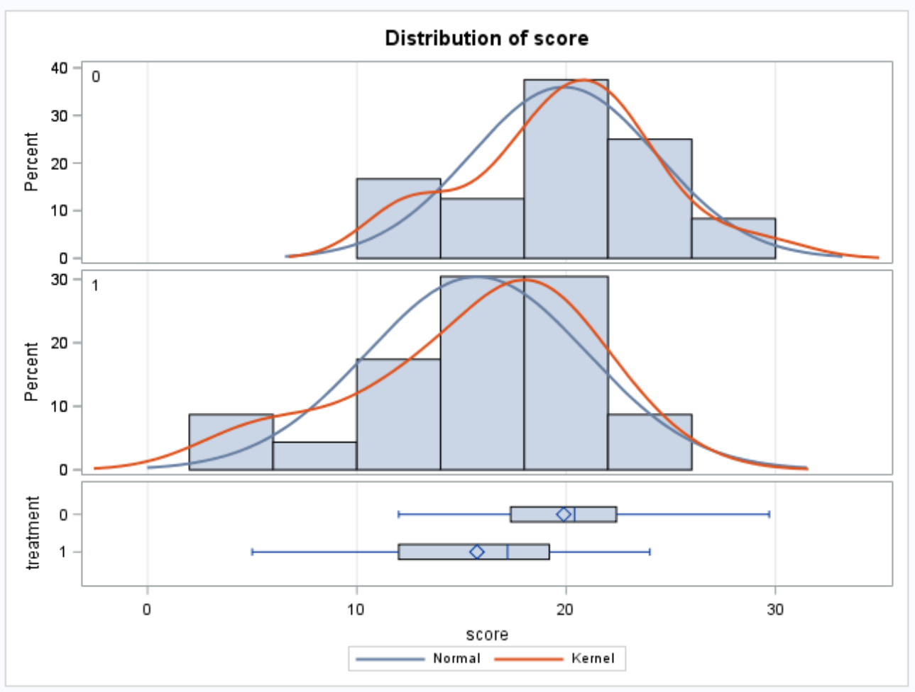
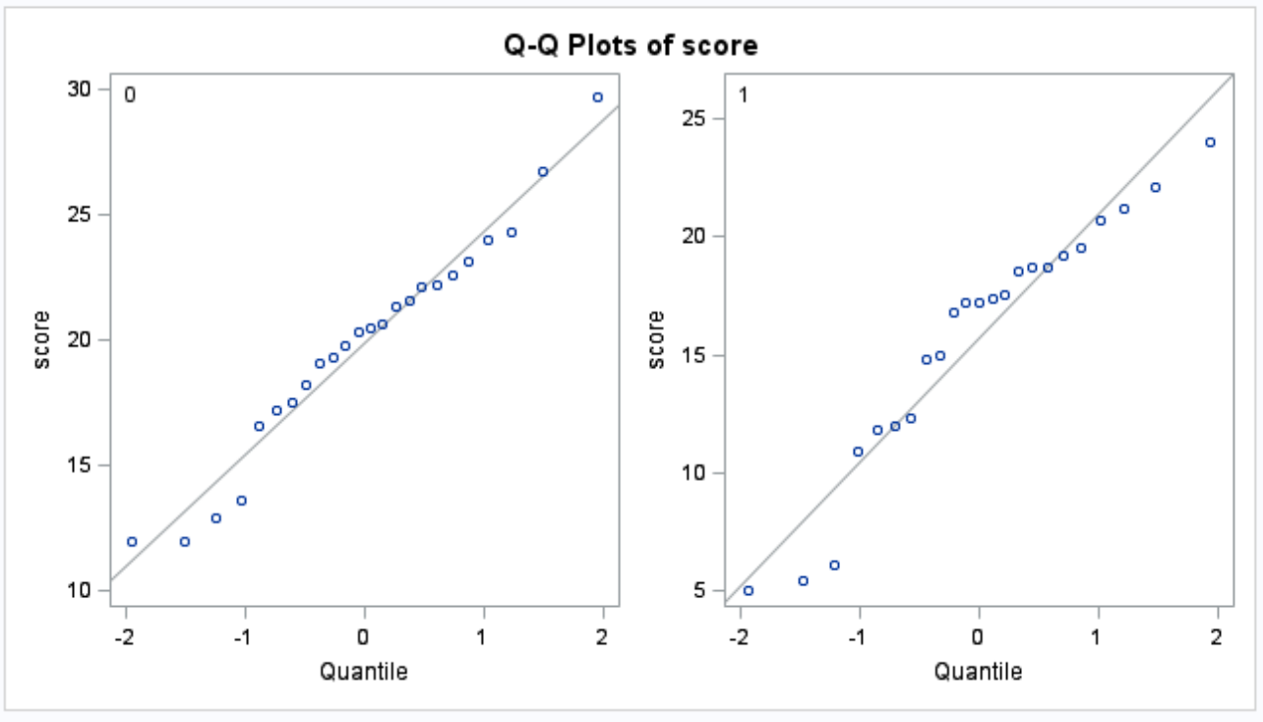
Normality Assumption- Creativity Data
Visual inspection of the histograms and q-q plots of each population are consistent with the normality of each population. We assume normality and move on to the second assumption.

Slide 12
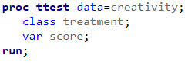
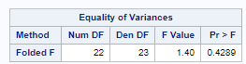
Equality of Variances – Creativity Data
A visual check was done by looking at the histograms, which reveal similar shapes and support the equal variances assumption. You can assume equal variances here.
Since we are able to assume normal population distributions, we can use the F-Test to provide secondary evidence if the visual is inconclusive. Since the p-value is greater than our significance level of alpha = 0.05, we fail to reject the null hypothesis of equality (p-value = 0.1043) and conclude that there is not enough evidence to suggest the variances are different.

Slide 13
Example: Creativity Data Independent Observations Assumption
State the Problem: We would like to test the claim that the mean score of those with intrinsic motivation is the same for those with extrinsic motivation.
Check Assumptions:
Normally Distributed Populations
Equal Standard Deviations
Independent Observations

Slide 14
Independent Observations – Creativity Data
The sample consisted of volunteers and thus subjects may not be independent of one another. We will assume independence and proceed with caution.

Slide 15
Example: Creativity Data Run the Test
State the Problem: We would like to test the claim that the mean intrinsic score is the same as the extrinsic score.
Check Assumptions:
Normally Distributed Populations
Equal Standard Deviations
Independent Observations
Run the Test:
1. First 5 steps.

Slide 16
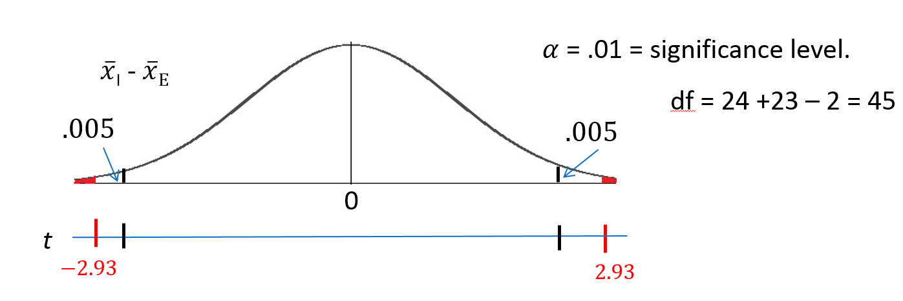
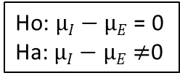
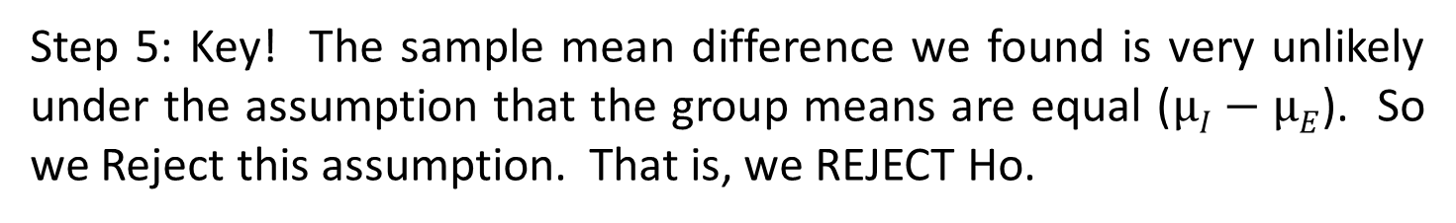
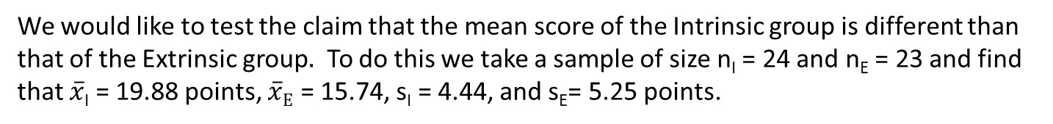
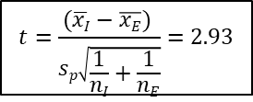
Let’s Formalize This Test Into 6 Steps
We would like to test the claim that the mean score of the Intrinsic group is different than that of the Extrinsic group$.$ To do this we take a sample of size n_{I} = 24 and n_{E} = 23 and find that $\overline{x}$_{I} = 19.88 points, $\overline{x}E$ = 15.74, s_{I} = 4.44, and s_{E}= 5.25 points.
Step 1: Identify the null (Ho) and alternative (Ha) hypothesis.
Ho: $µI−µE$ = 0
Ha: $µI−µE$ $≠$0
Step 2: Draw and Shade and Find the Critical Value.
proc ttest data=creativityData; class group; var score; run;
$$t=\frac{(\overline{xI}−\overline{xE}) }{sp\sqrt{\frac{1}{nI}+\frac{1}{nE}}}=2.93$$
Step 3: Find the test statistic. (The t value for the data.)
Step 4: Find the p-value: P-value 0.0054< .01
Step 5: Key! The sample mean difference we found is very unlikely under the assumption that the group means are equal ($µI−µE$). So we Reject this assumption. That is, we REJECT Ho.

Slide 17
Example: Creativity Data State the Scope and Conclusion
State the Problem: We would like to test the claim that the mean intrinsic score is the same as the extrinsic score.
Check Assumptions:
Normally Distributed Populations
Equal Standard Deviations
Independent Observations
Run the Test: First 5 steps.
State the Scope and Conclusion: Step 6

Slide 18
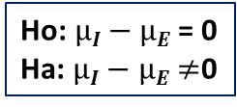
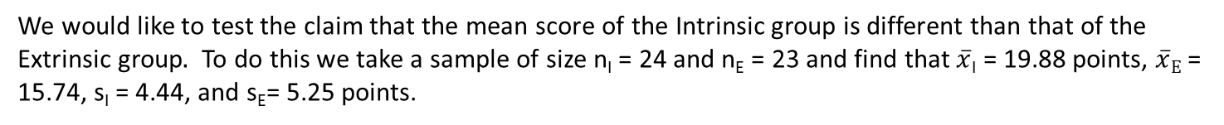
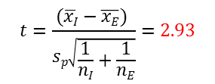
Let’s Fill in the P-value (and add a CI) – Creativity Data
We would like to test the claim that the mean score of the Intrinsic group is different than that of the Extrinsic group$.$ To do this we take a sample of size n_{I} = 24 and n_{E} = 23 and find that $\overline{x}$_{I} = 19.88 points, $\overline{x}E$ = 15.74, s_{I} = 4.44, and s_{E}= 5.25 points.
Step 1: Identify the null (Ho) and alternative (Ha) hypothesis.
Ho: $µI−µE$ = 0
Ha: $µI−µE$ $≠$0
Step 2: Draw and Shade and Find the Critical Value.
$$t=\frac{(\overline{xI}−\overline{xE}) }{sp\sqrt{\frac{1}{nI}+\frac{1}{nE}}}=2.93$$
Step 3: Find the test statistic. (The t value for the data.)
Step 4: Find the p-value: P-value = .0054
Step 5: REJECT Ho
Step 6:
Conclusion: There is sufficient evidence to suggest that those who receive the Intrinsic treatment have a higher mean score than those who receive the Extrinsic treatment (p-value = .0054 from a two sided t-test). A 99% confidence interval for this difference is (1.29, 7.00).
SCOPE: Since this was a randomized experiment, we can conclude that the Intrinsic treatment caused this difference. However, since the study was of volunteers, this inference can only be generalized to the 47 participants.

Slide 19
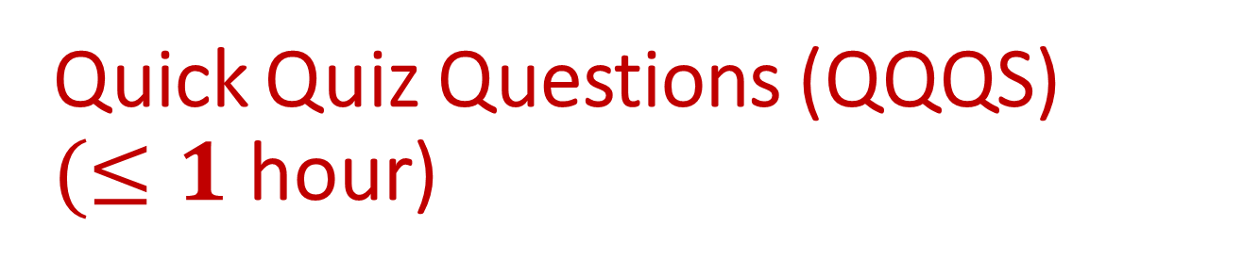
Quick Quiz Questions (QQQS) $(≤1$ hour)

Slide 20
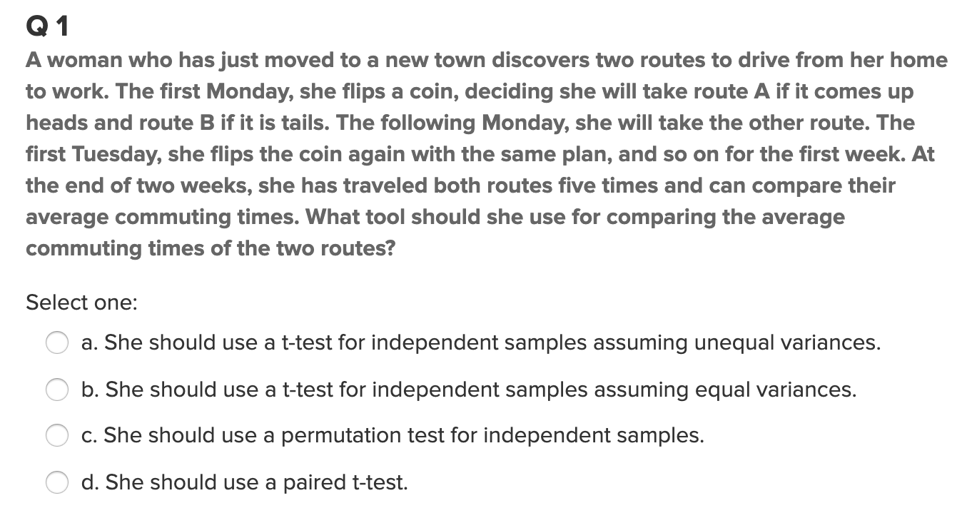
Quick Quiz Question 1
Answer: D

Slide 21
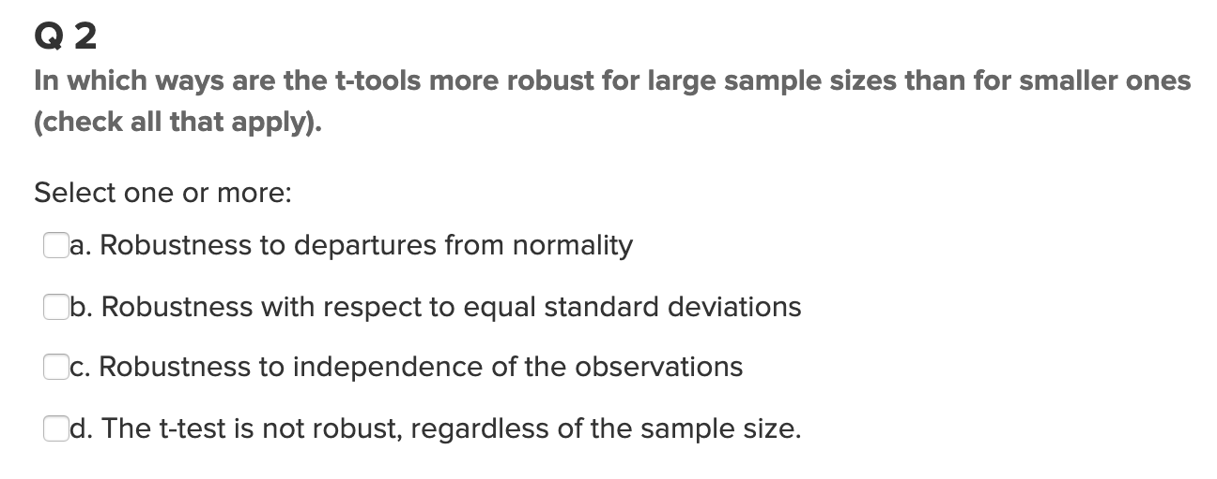
Quick Quiz Question 2
Answer: A & B

Slide 22
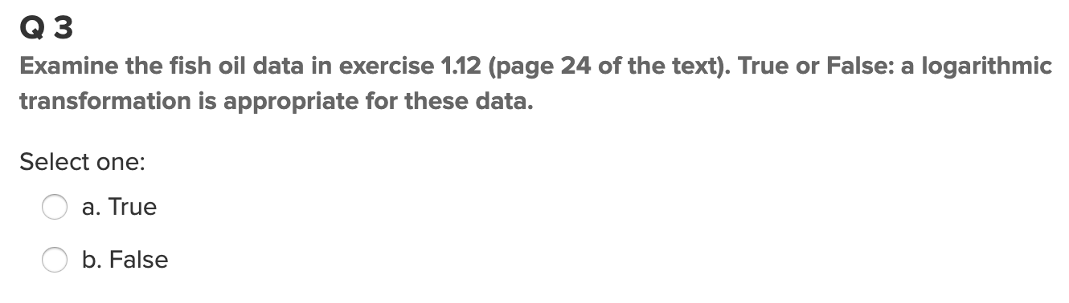
Quick Quiz Question 3
Answer: B

Slide 23
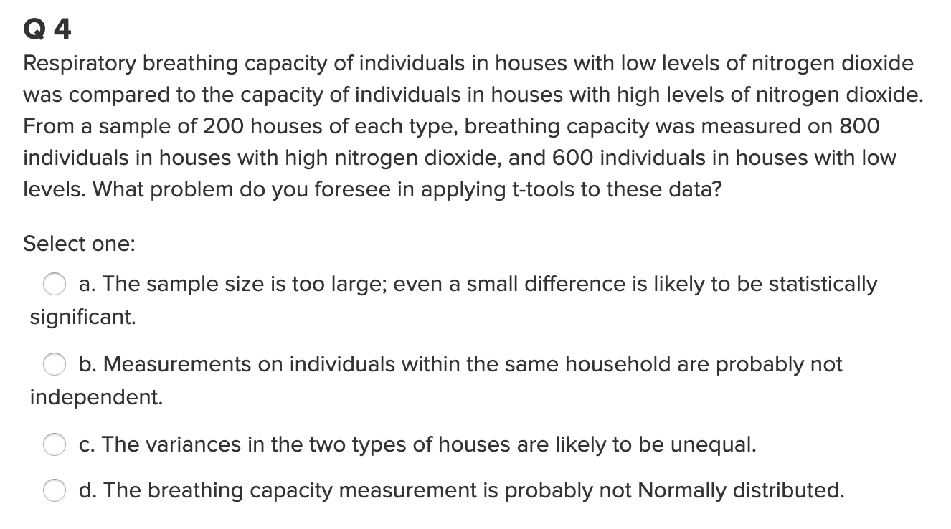
Quick Quiz Question 4
Answer: B

Slide 24
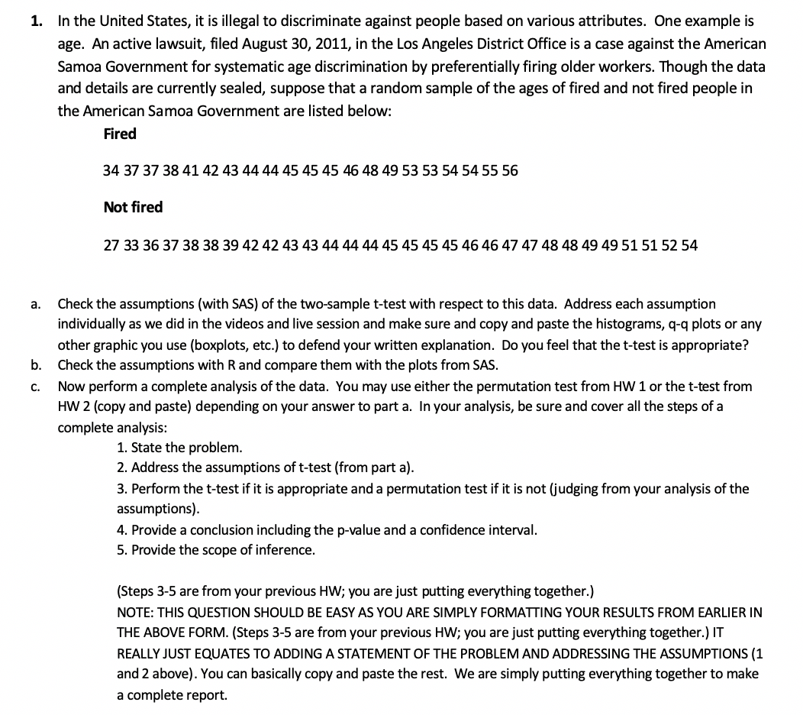

Question 1: ( $≤2 hours)$

Slide 25
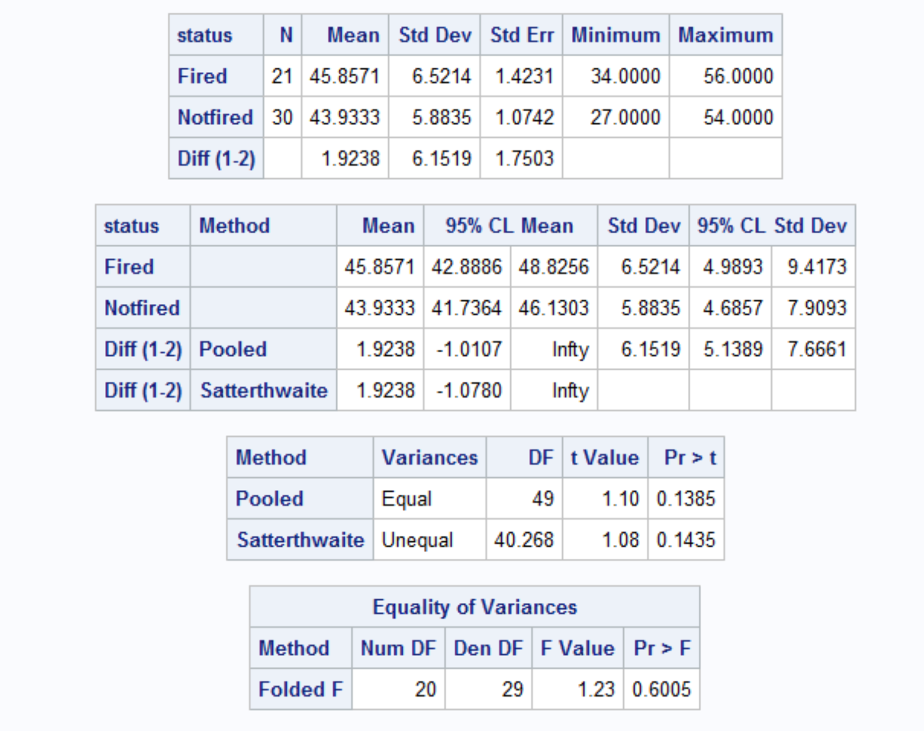
Question 1A

Slide 26
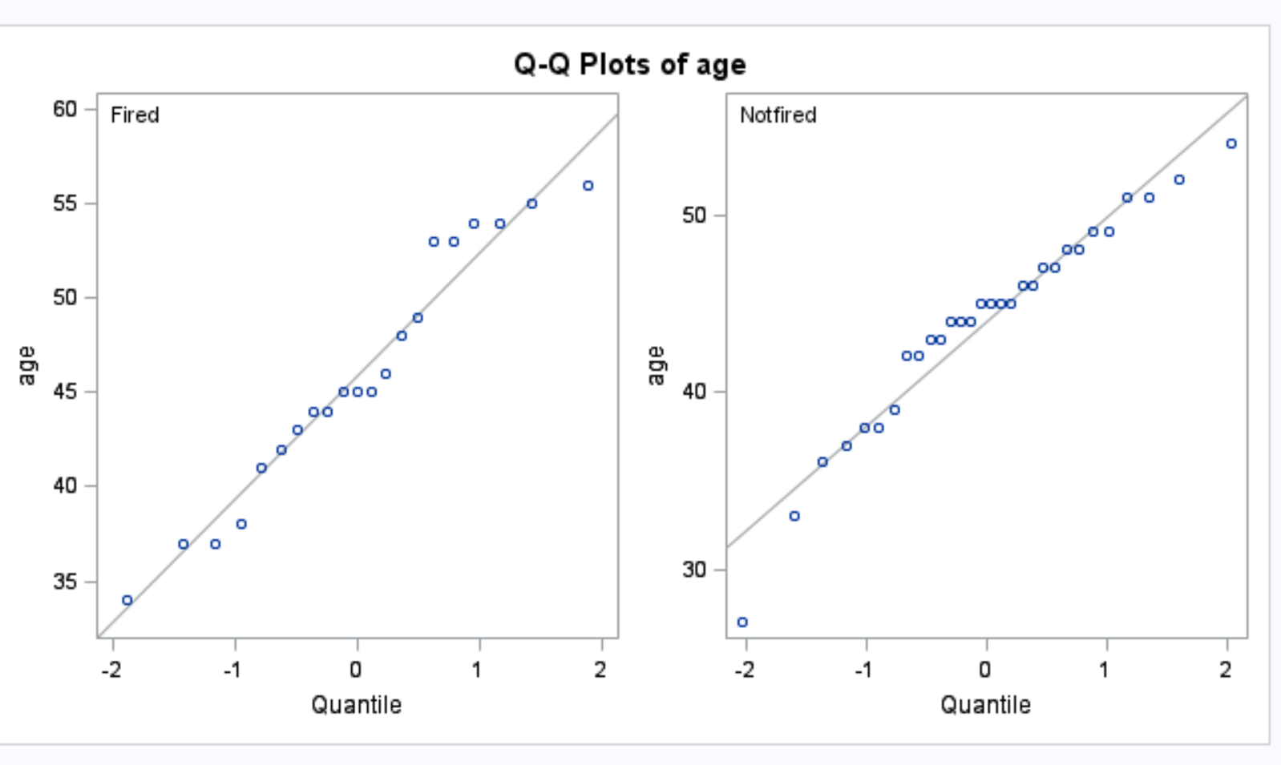
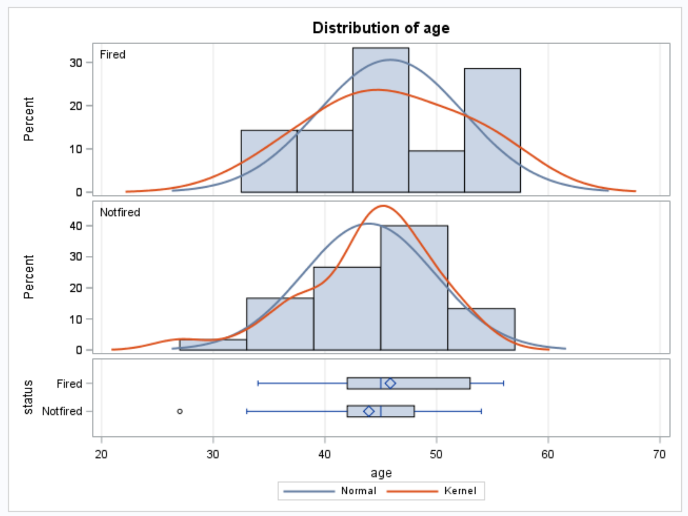
The distribution looks equal in standard deviation. The observations also look like they are independent between each other.

Slide 27
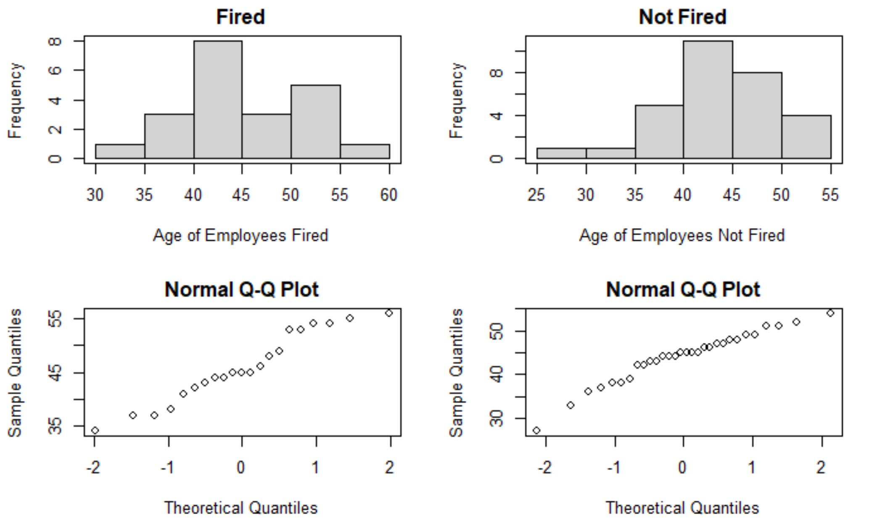
The data looks the same between SAS and R.

Slide 28

Question 1 - Continued( $≤2 hours$)

Slide 29
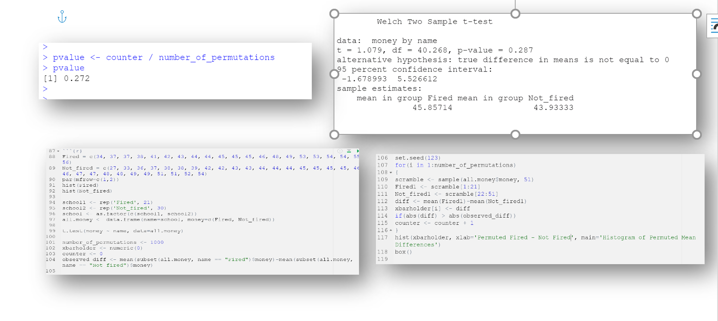

Slide 30
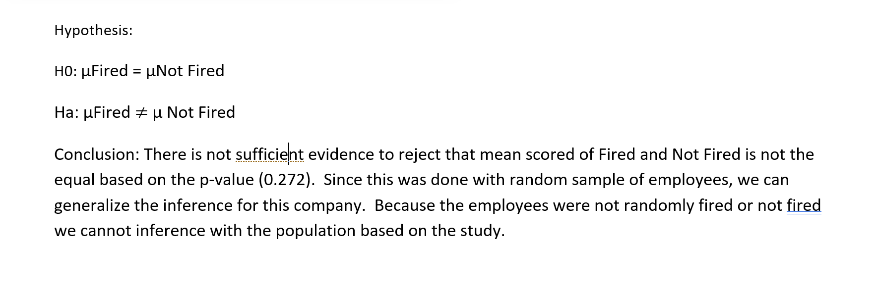

Slide 31
Note: Perhaps you might be wondering at this point in the course:
“Why are we always testing the assumptions of the t-test? Is it the best test?
Should we always run the t-test when we can?”
These are very good questions and open questions that are up for debate! The one thing that is mathematically proven and not up for debate is that if the assumptions are met, the two-sample t test is the most powerful (in terms of Power = 1 – beta) test in the universe at testing the claim of the difference of means. Two questions may arise here:
1. Do we ever really have the assumptions fully met in the real world and just how much power do we give up at varying degrees of violation of the assumptions?
2. Do we always want inference on the equality/difference of means?
We will continue to answer these questions in Unit 4. Also note that we started to answer number two with a t-test of log transformed data. The inference there is on the equality (ratio) of medians which may be a better measure of center when dealing with right or left skewed data!)

Slide 32
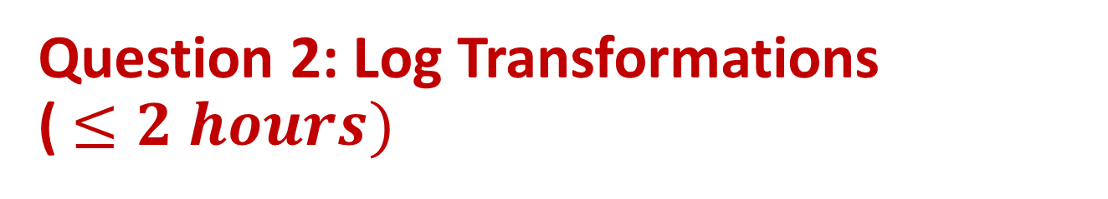
Question 2: Log Transformations ( $≤2 hours)$
After completing the video lecture on log transformations, answer the following question and we will revisit it in live session.

Slide 33


Question 2: Does Cloud Seeding Work?
On days that were deemed suitable for cloud seeding, a random mechanism was used to decide whether to seed the target cloud on that day or to leave it unseeded as a control. Precipitation was measured as the total rain volume falling from the cloud base following the airplane seeding run, as measured by radar. Test at the alpha = .05 level of significance whether cloud seeding is effective in increasing precipitation. Do not forget to check assumptions and make a transformation if required.

Slide 34
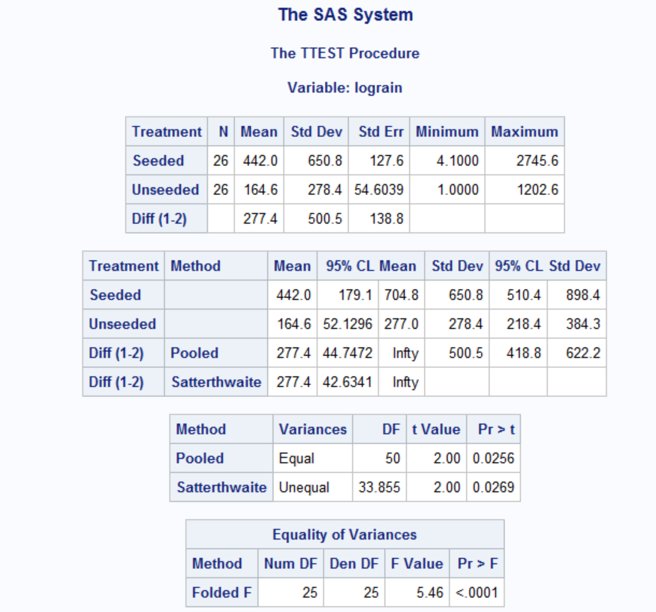

Slide 35
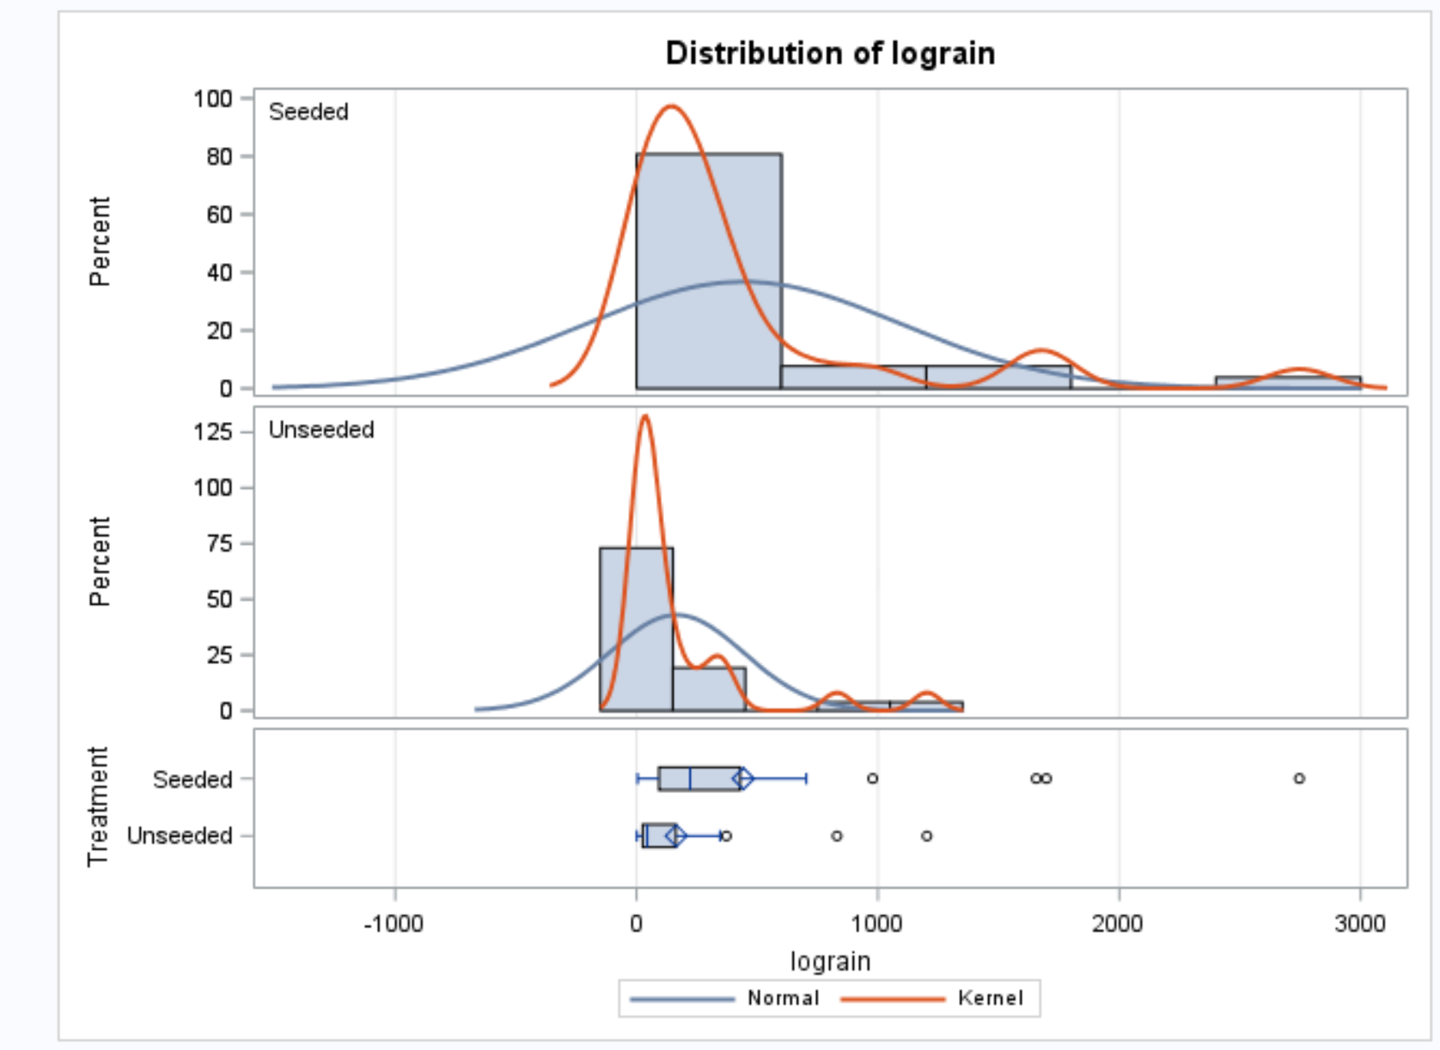

Slide 36
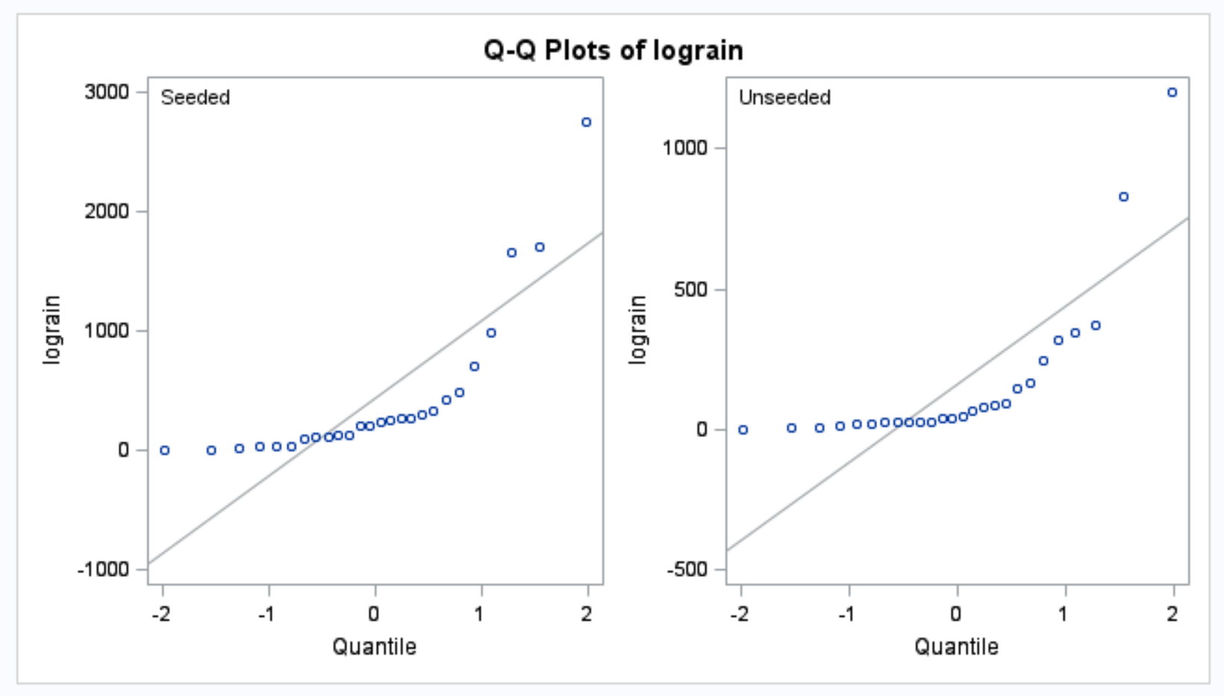

Slide 37
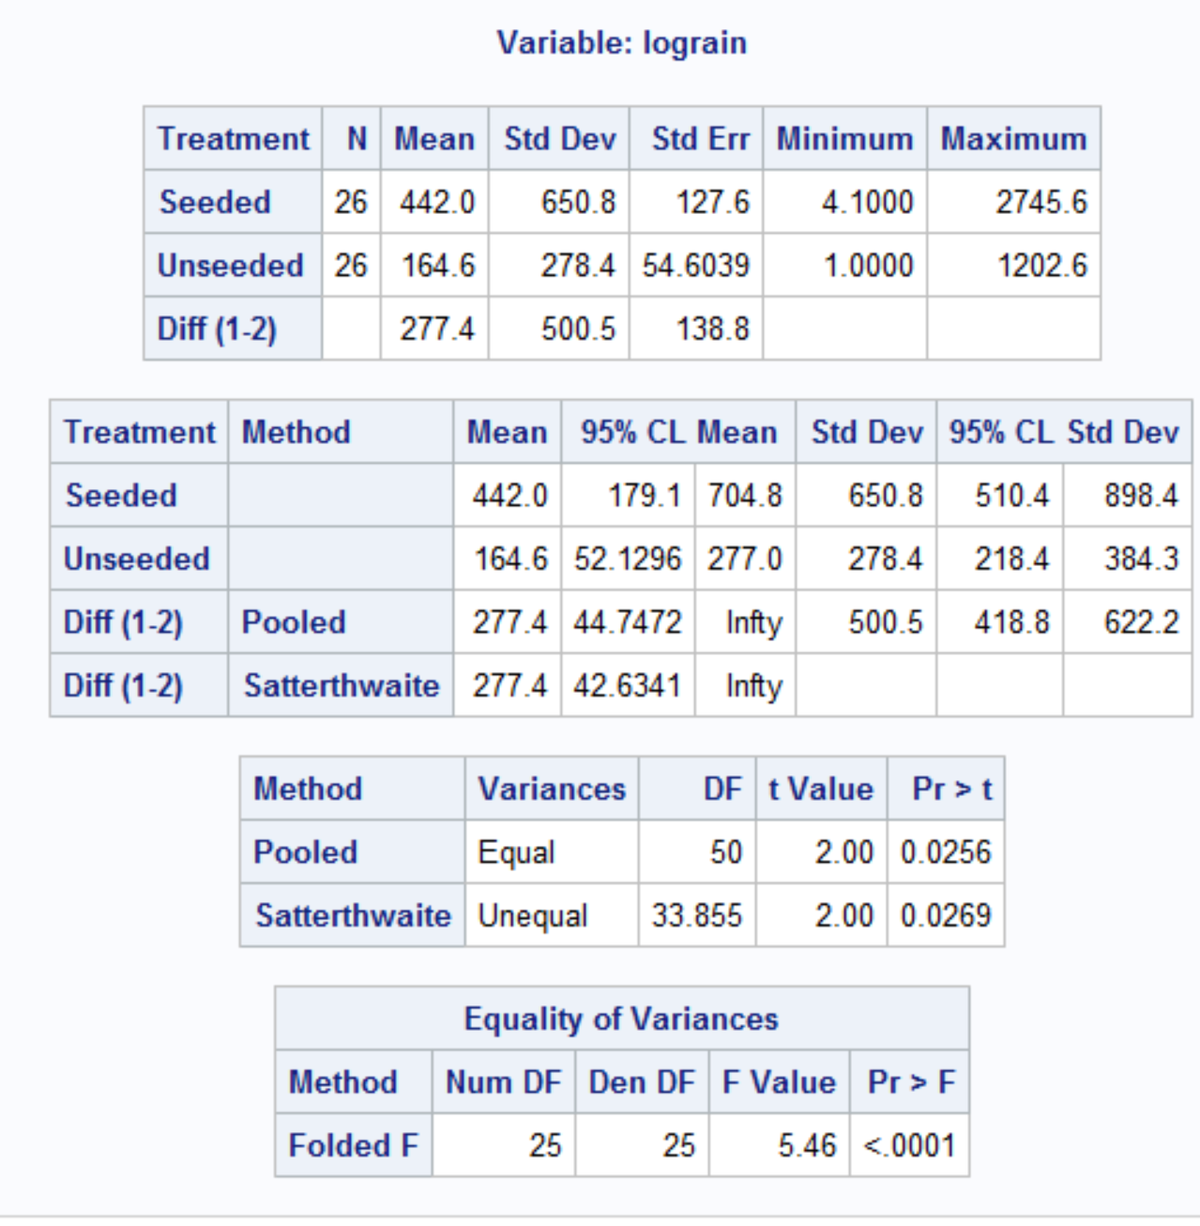

Based on the p-value of 0.0511 we can assume that seeding has paid role of doubling the rain. The study seeding and unseeding was done through random sampling and selection to test is also random. So we can assume there is enough evidence that seeding has increasing the rainfall in this study and can be applied to general population.

Slide 38
Example Write Ups….
Observational Study:
“It is estimated that the median for population X is exp(mean(log(x)) – mean(log(y))) times as large as the median for population Y.”
Randomized Experiment:
“It is estimated that the median response of an experimental unit to treatment x will be exp(mean(log(x)) – mean(log(y))) times as large as its response to treatment y.”

Slide 39
Recap: The Take Away
What you will find in practice will most likely not fit exactly into the scenarios we identified here. There will be some judgment involved … this is the “art” of statistics.
Here are some general rules of thumb that we will assume this semester.
If sample sizes are the same and sufficiently large, the t tools (tests and confidence intervals) are valid … since they are robust to the violation of normality.
If the two populations have the same standard deviation then the t tests are valid … given sufficient sample sizes.
If the standard deviations are different and the sample sizes are different then the t tools are not valid and another procedure should be used. (Ch. 4)

Slide 40
Question 3
Please provide your takeaways (at least 4) from this unit and any question you may have.
Comparing t-tests to permutations tests.
The distribution testing is not best solutions when the data is skewed.
Testing case assumptions and making sure the data itself makes sense.
Understanding that the null hypothesis you are just not accepting when the p-value is high but not out right providing 100% confidence in the decision.

